Slide 1
PRODUCT DESIGN DEVELOPMENT PROJECT -THE EASY WASHING SCRUB
Sasikumar. M -17BME015
Karthik -17BME018
Deepan.J -17BME021
Barath.M -17BME024

Slide 2

TABLE OF CONTENT
Problem Statement
Objectives
Survey
Literature Survey
Market Survey
Product Specifications
Project Planning - Gantt Chart
References

Slide 3
PROBLEM STATEMENT
it’s a difficult task to use the scrub and soap alternately.
1
They have to apply soap and then use the scrub to remove the dirt again in different spots.
2
Sometimes the soap bar might stick to the cloth and it would be a hard time to remove it.
3

Slide 4
OBJECTIVE
To create a product to simplify the task of washing clothes using hands is required.
Combining a scrub and liquid soap that could be applied in required spots with just a push of a button.

Slide 5
MARKET SURVEY

Slide 6
MARKET SURVEY

Slide 7
LITERATURE SURVEY
The object of the present invention is to provide aretractable brush including a bristle extender with a push button resiliently held in a hollow casing which can be applied with water

Slide 8
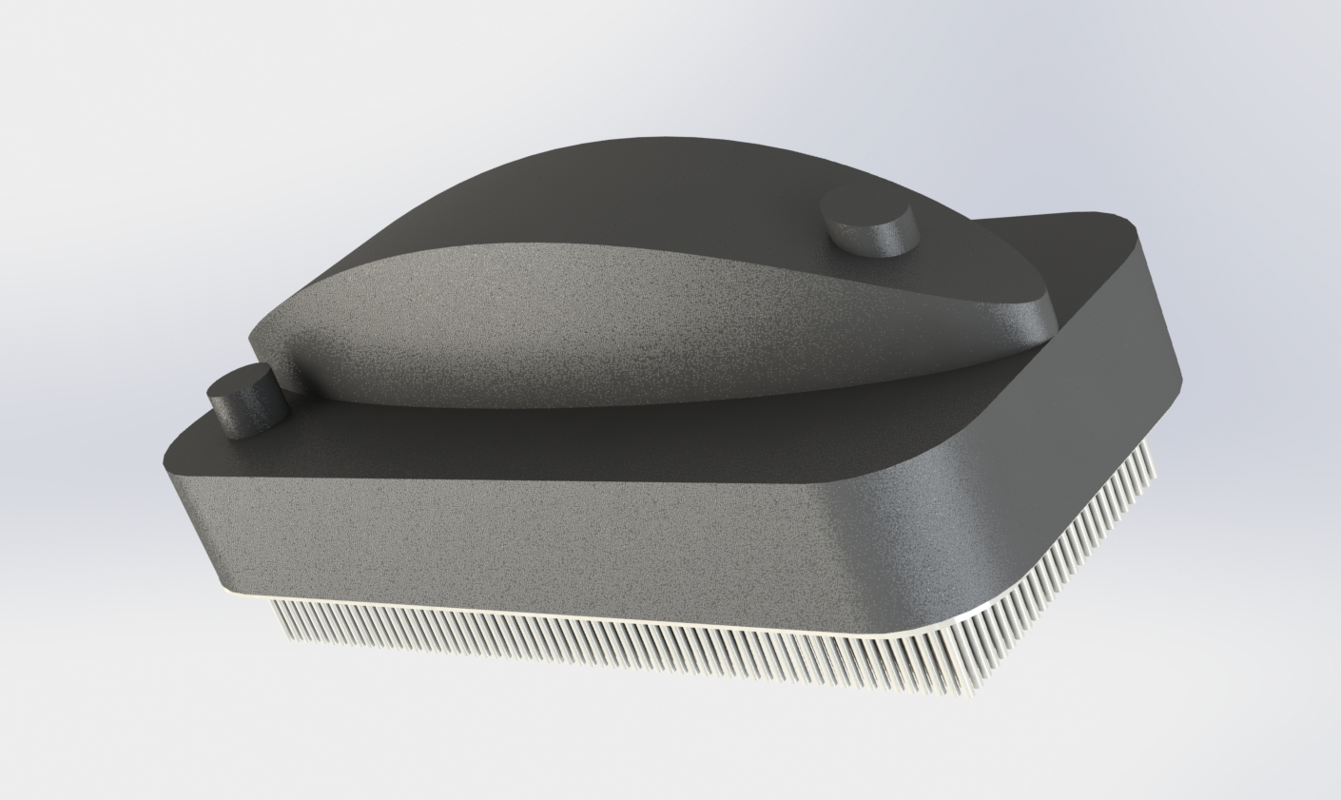
PRODUCT SPECIFICATIONS AND DESIGN
PRODUCT SPECIFICATIONS
140×65×60 mm
Button radius -4mm
Cap radius -5mm
Hole radius -3mm
Bristles length -15mm

Slide 9
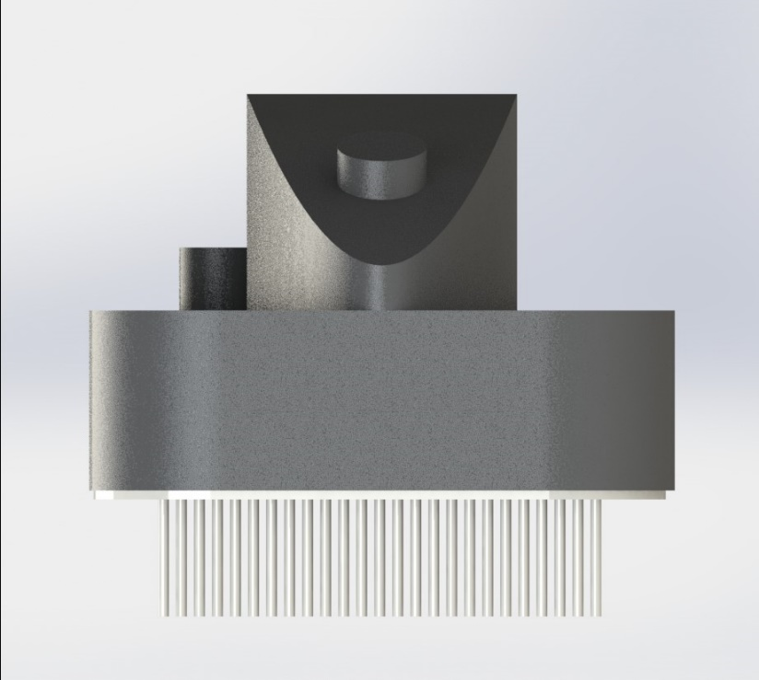
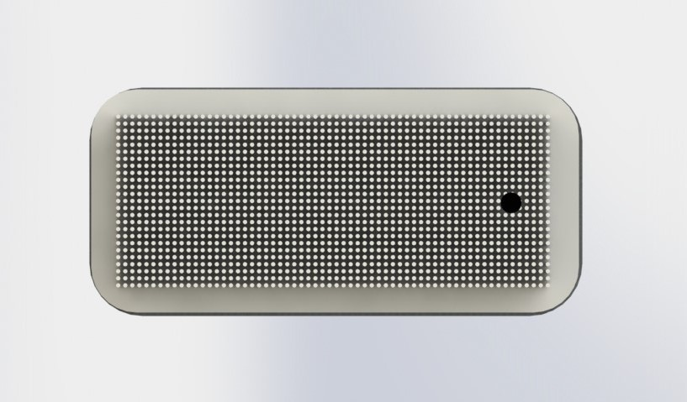
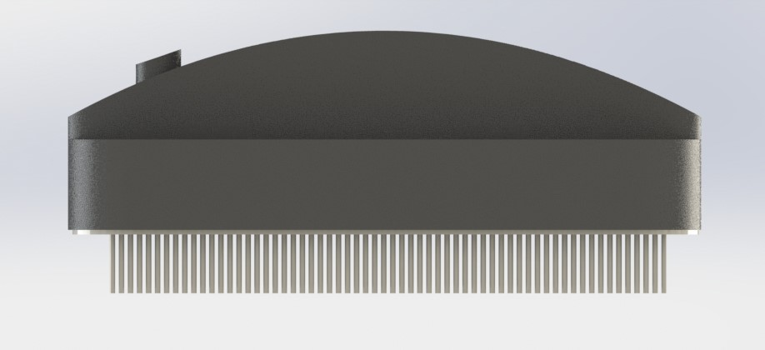
DESIGN STRUCTURE

Slide 10
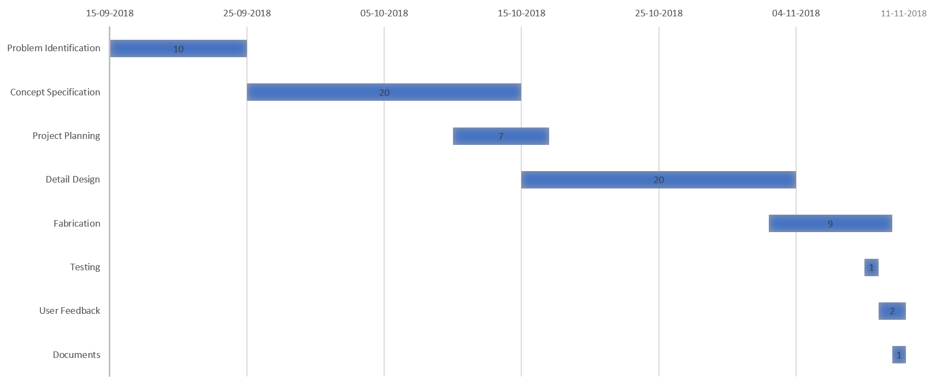
GANTT CART

Slide 11
BILL OF MATERIALS

Slide 12
REFERENCES
WEBSITES:
https://www.bhg.com/homekeeping/laundry-linens/clothes/how-to-wash-clothes-by-hand/
ARTICLES:
http://time.com/5254808/
PRODUCT SITES:
https://www.amazon.in/DANNU-cleaning-CLEANING-Dispenser-Multicolour/dp/B075PDZY1P

